Slide 1
JavaScript (ES6)
Installation and Setup

Slide 2
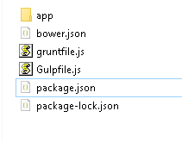
Package Structure From GITHub

Slide 3
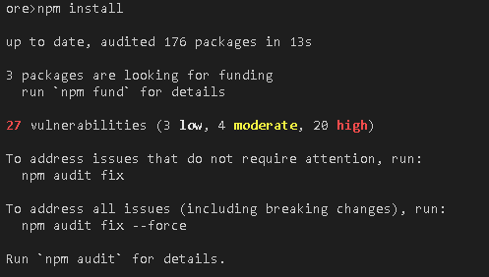
npm install

Slide 4
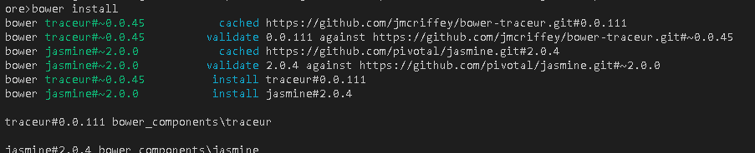
bower install

Slide 5

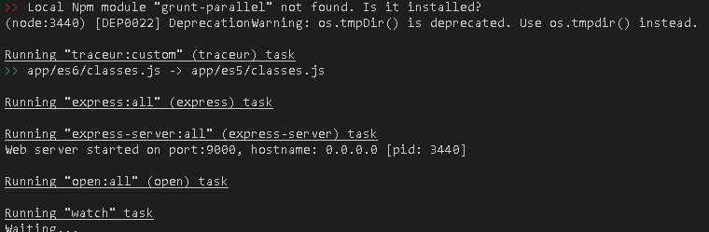
Run grunt to start Jasmine

